Slide 1


POPCORN CITY
Made by: Szabolcs Ördög ,Tamás Pásztor, Bence Török
https://github.com/asd/mozi/cinemacity

Slide 2







Programming languages and environments

Slide 3





Implementation process
Connecting Frontend and Backend
Connecting the functions on the site to the backend.
Database design
We designed the database and the relationships between them.
Backend development
Creation of database queries and post methods.
Project planning
We planned what the page should be about and what functions it should have
Frontend development
Designing the style of the page.
Adding pages and features

Slide 4



Purpose of the site
From the site
Site Features
General information about the site
The site provides an online interface for a cinema.
It enables users to find information and conveniently book tickets.
Admin
User
Modification of page content
Delete items
View statistics and data
Add movies
Viewing the movies on the site
Ticket booking
Viewing the buffet's offer
Viewing ticket prices
Page properties
User-friendly design
Comfortable usability
The page is not refresh
Spectacular elements
Modern style

Slide 5
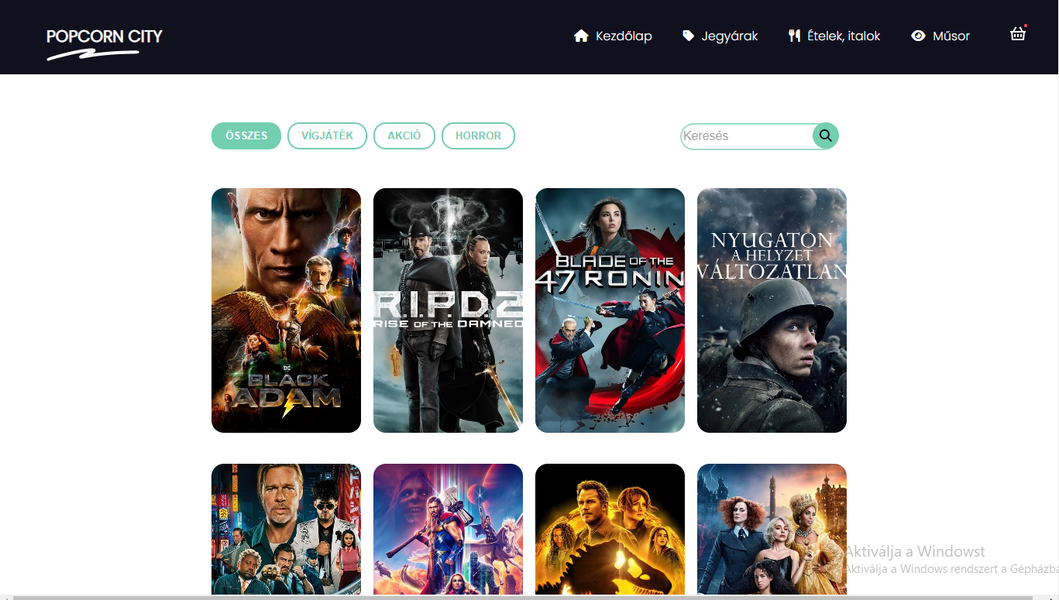
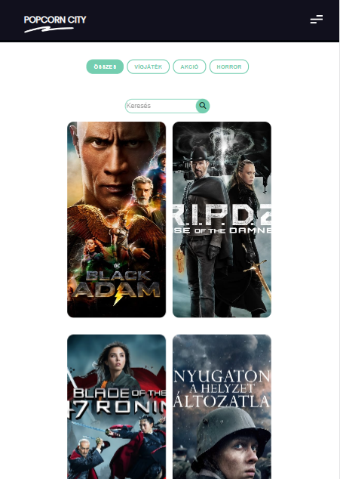
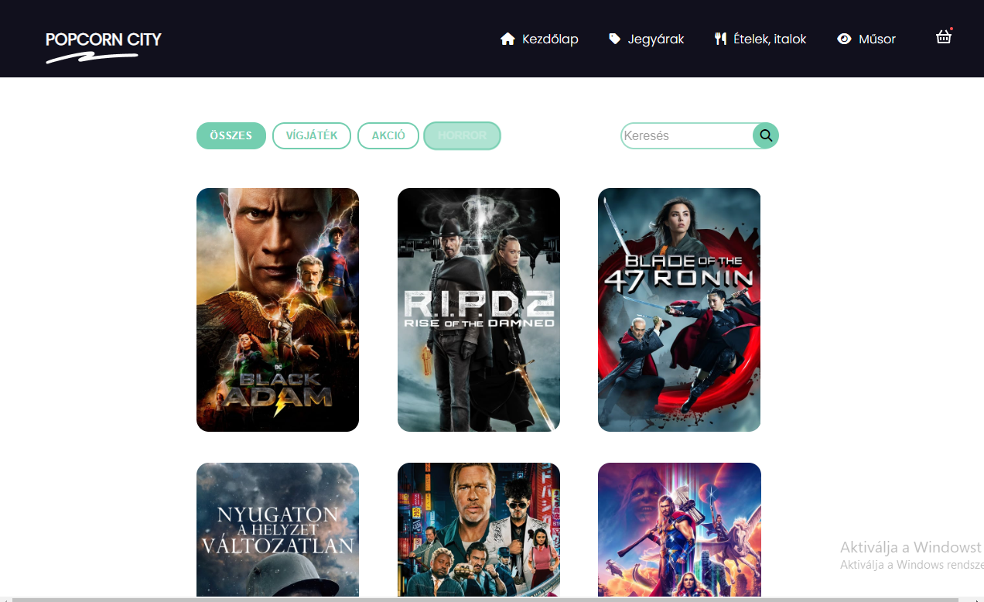
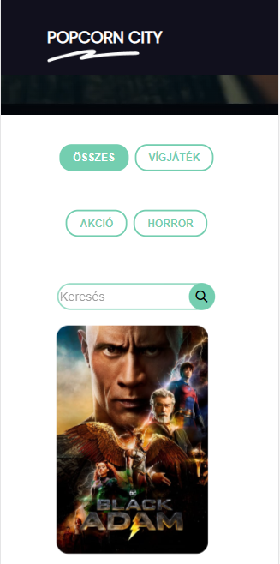
Responsiveness of the page
Tablet view
Phone view
Desktop view
Notebook view

Slide 6
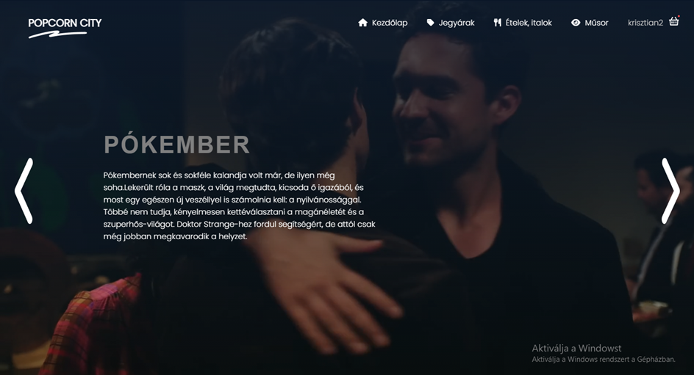

Slide 7

System requirements
CPU
Intel Core 2 Quad CPU Q6600
@ 2.40GHz (4 CPUs) / AMD
Phenom 9850 Quad-Core
Processor (4 CPUs) @ 2.5GHz
Sound
100% DirectX 10 compatible
GPU
NVIDIA 9800 GT 1GB / AMD HD
4870 1GB (DX 10, 10.1, 11)
DX: 10
Storage
5 GB szabad terület
Operating System
Windows 10 64 Bit, Windows 8.1
64 Bit, Windows 8 64 Bit,
Windows 7 64 Bit
RAM
4 GB RAM

Slide 8
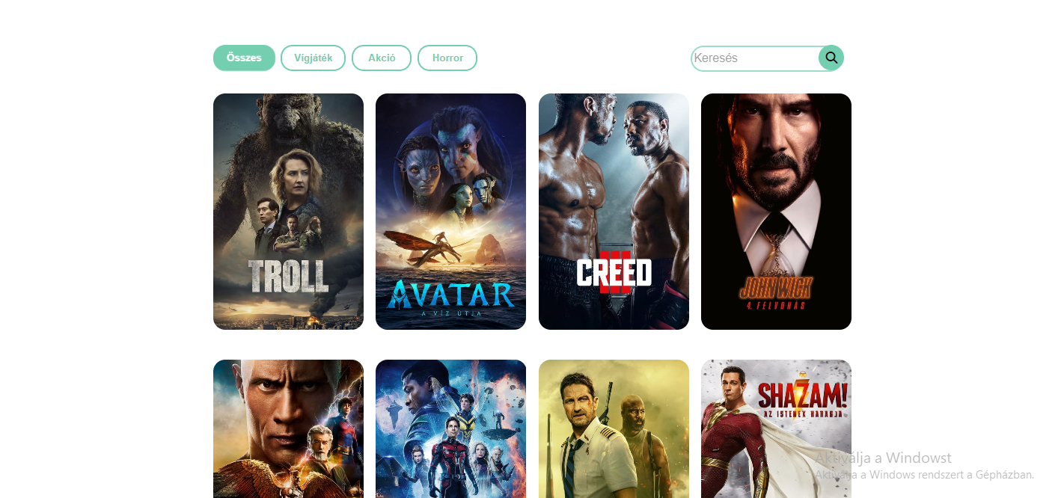
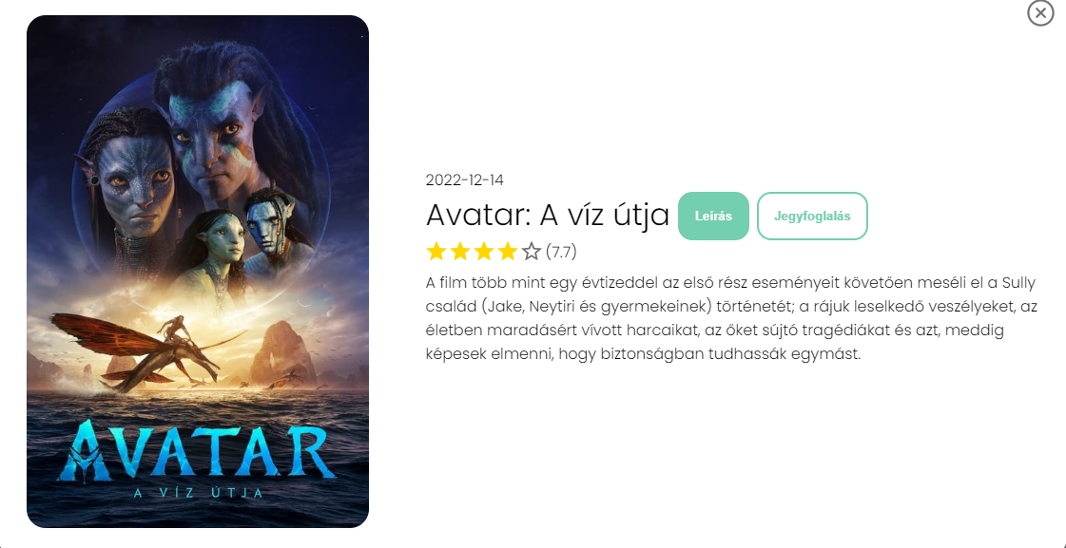

Slide 9
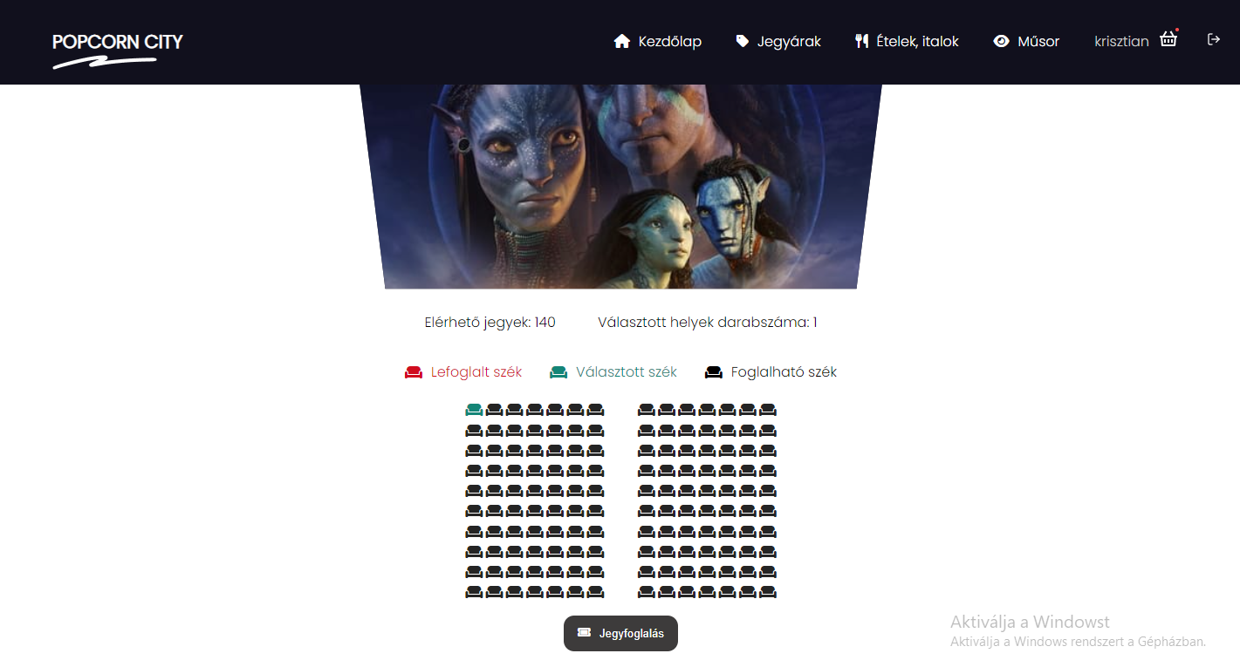
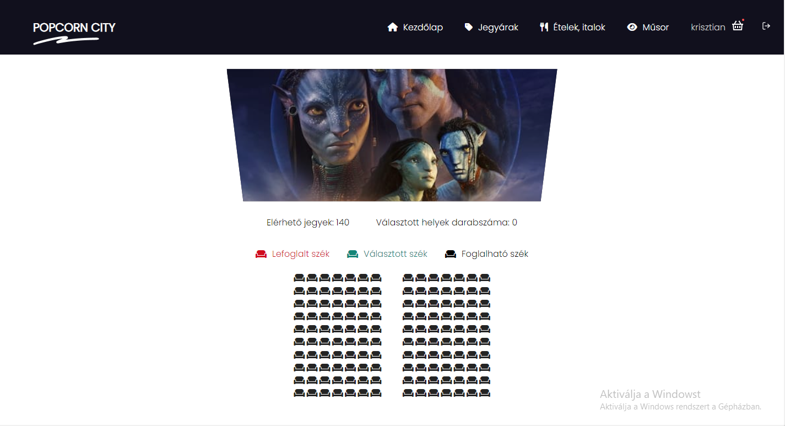

Slide 10
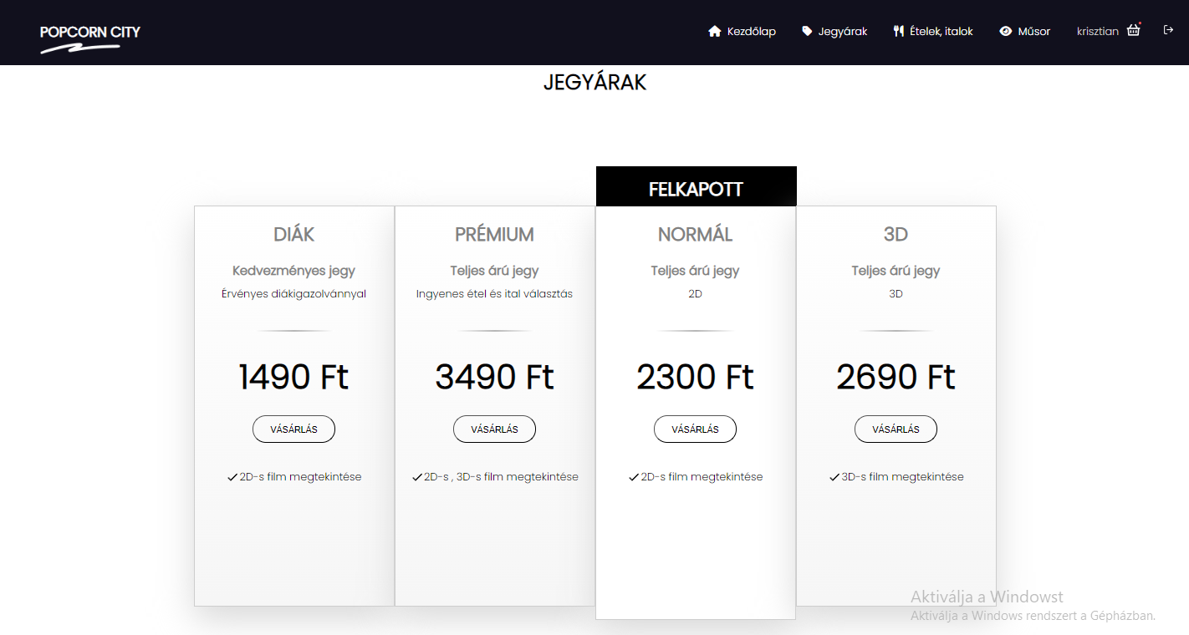

Slide 11
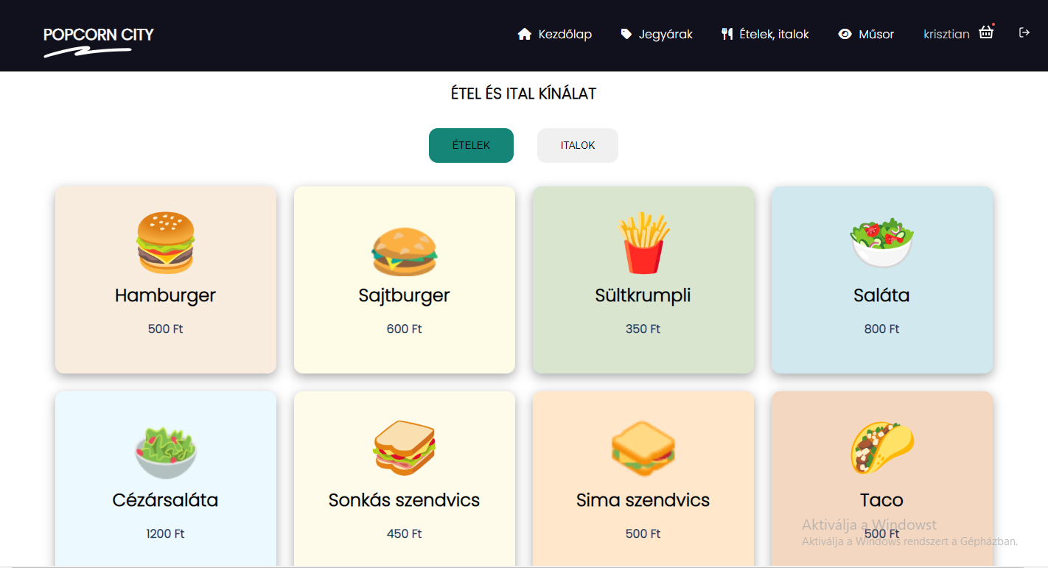

Slide 12
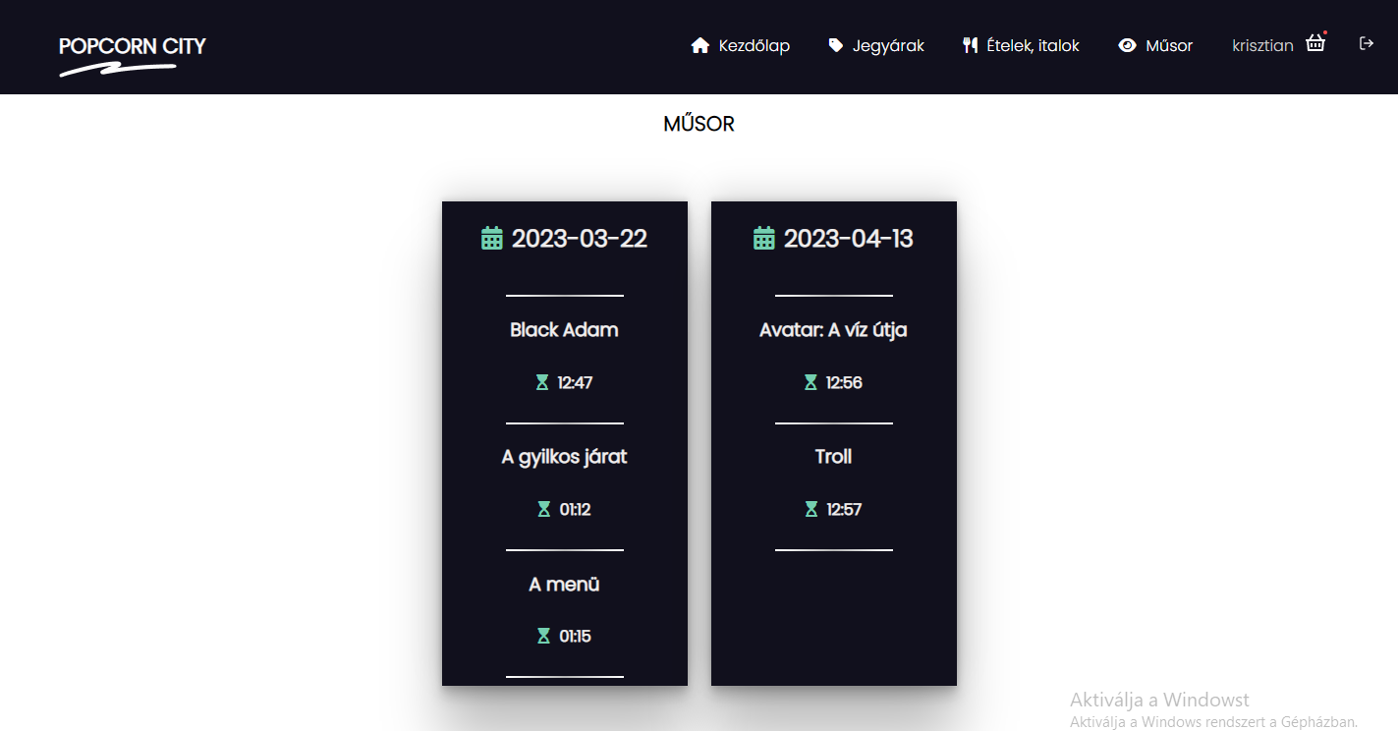

Slide 13
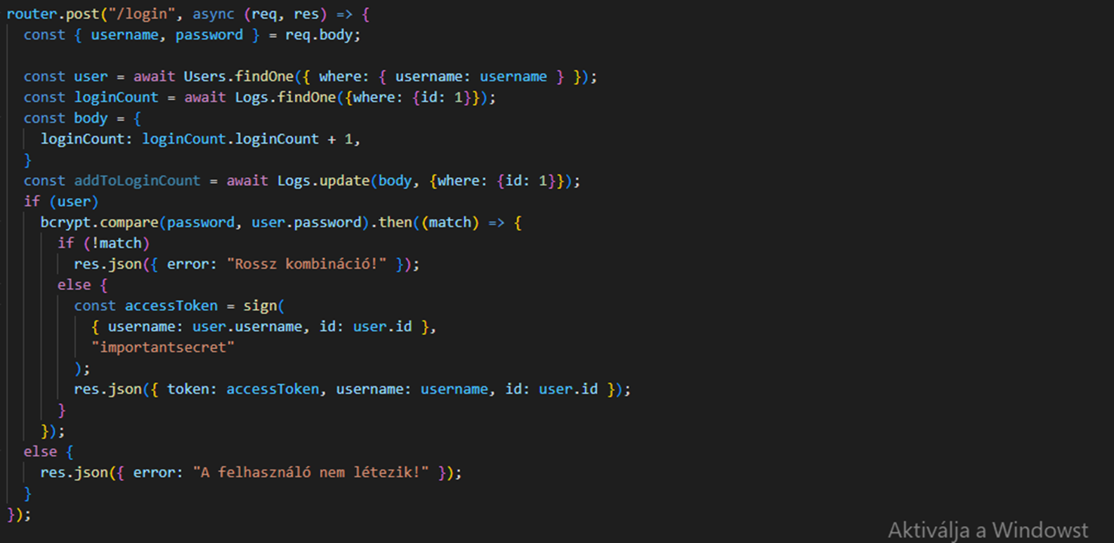
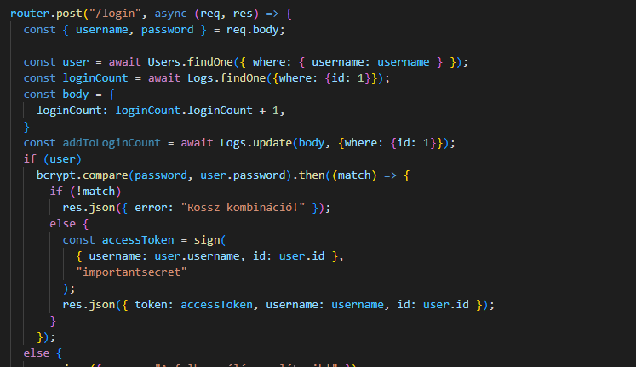
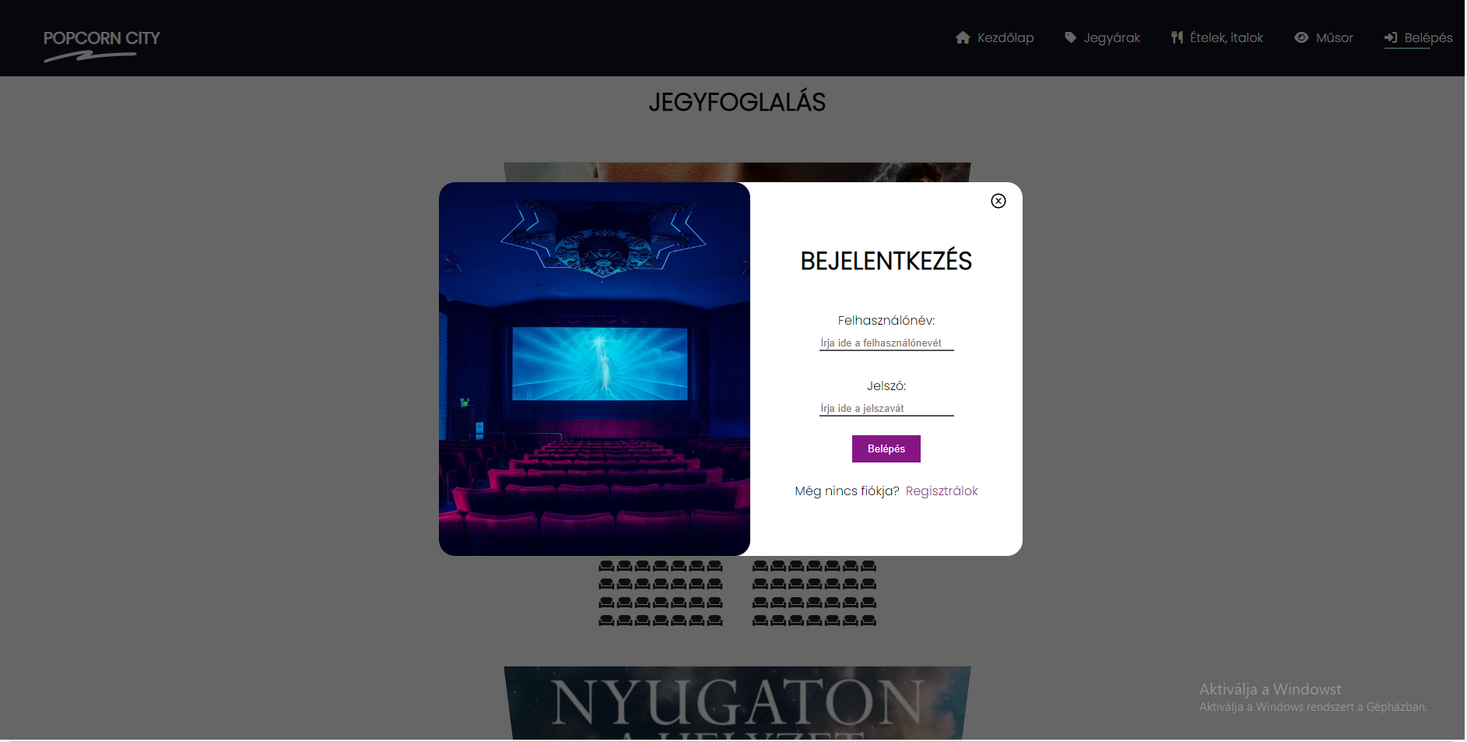

Slide 14
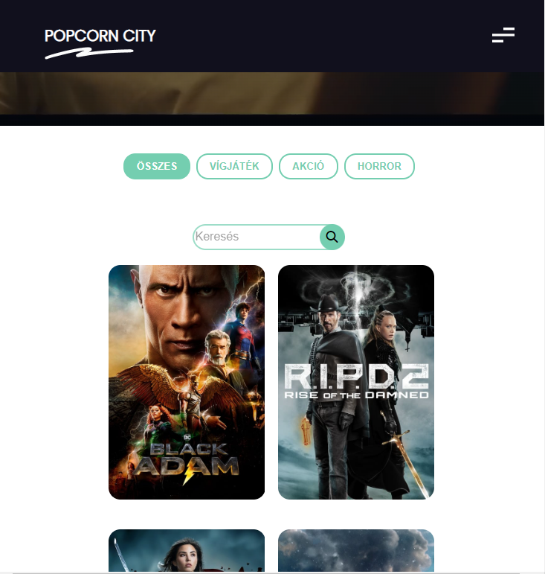
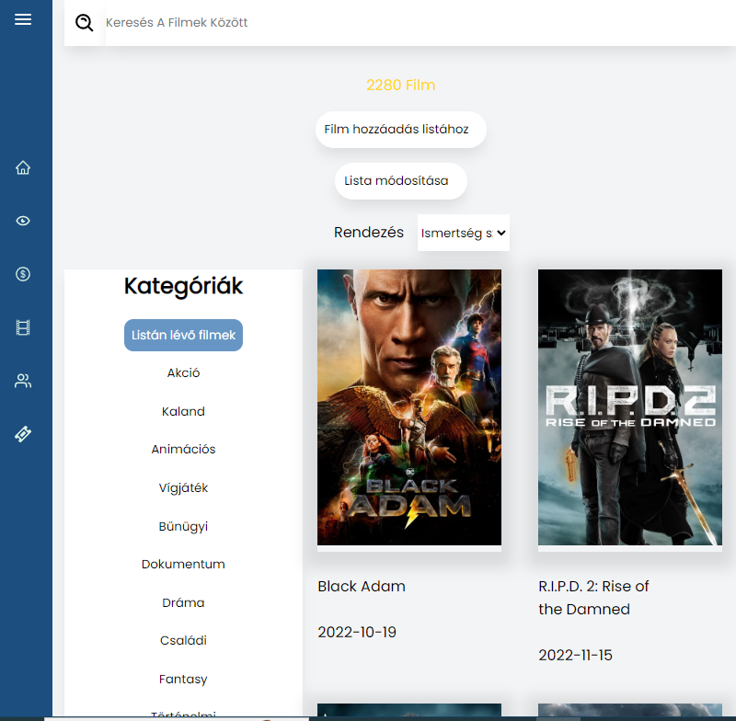
User / Admin

Slide 15
Home
Statistics & dates
On show
Show currently showing movies
Ticket prices
Editing & expanding the currently available tickets
Movies
The movies that can be screened at the moment
Users
Show users and delete
Ticket reservations
View current bookings

Slide 16
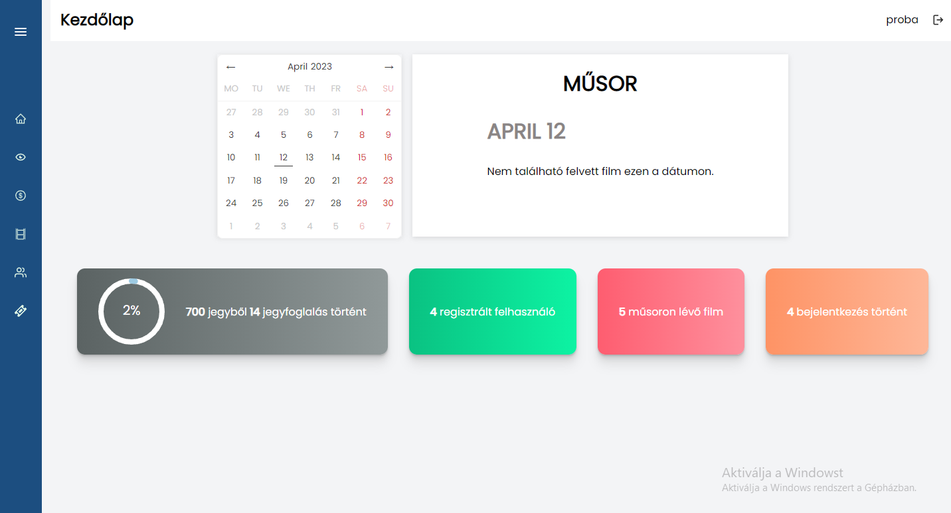

Slide 17
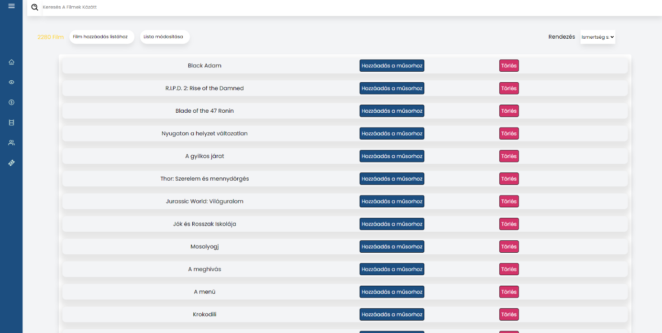

Slide 18
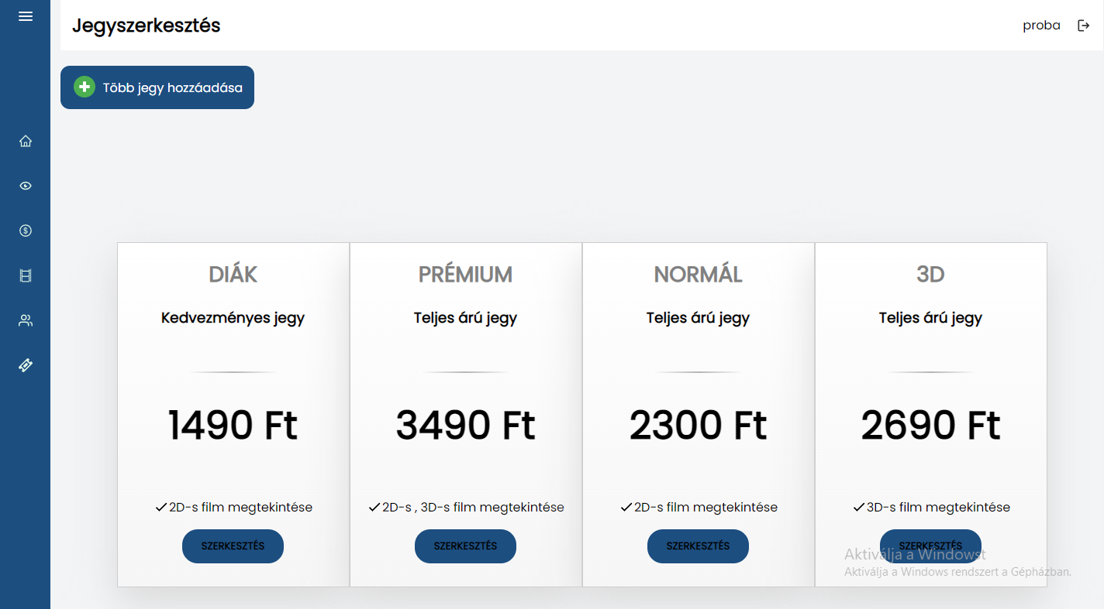

Slide 19
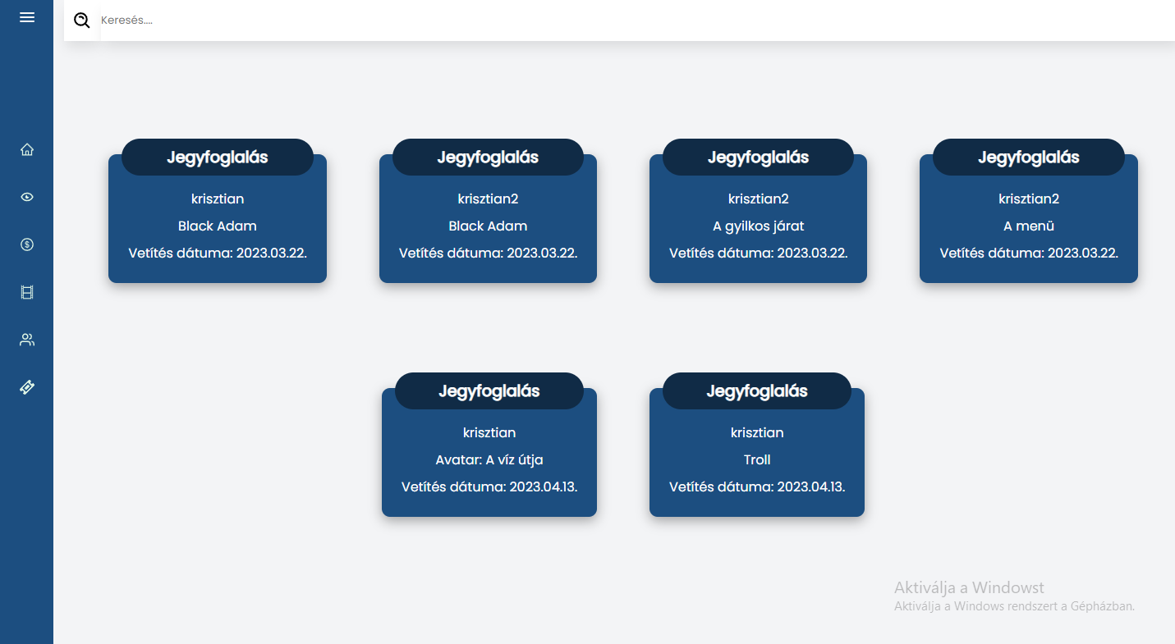

Slide 20
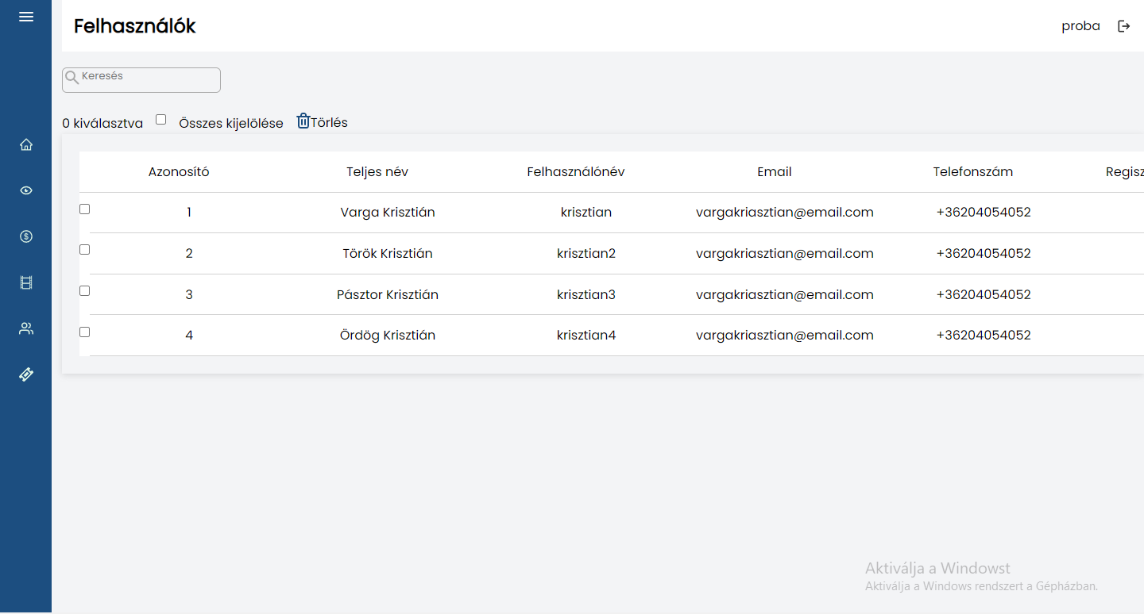

Slide 21
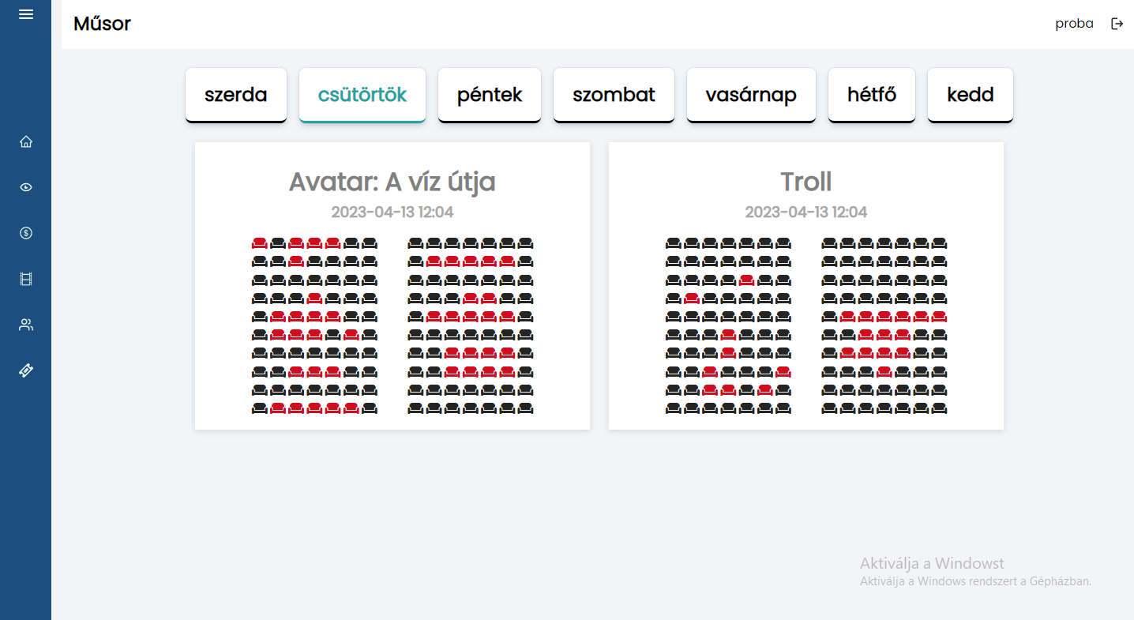

Slide 22
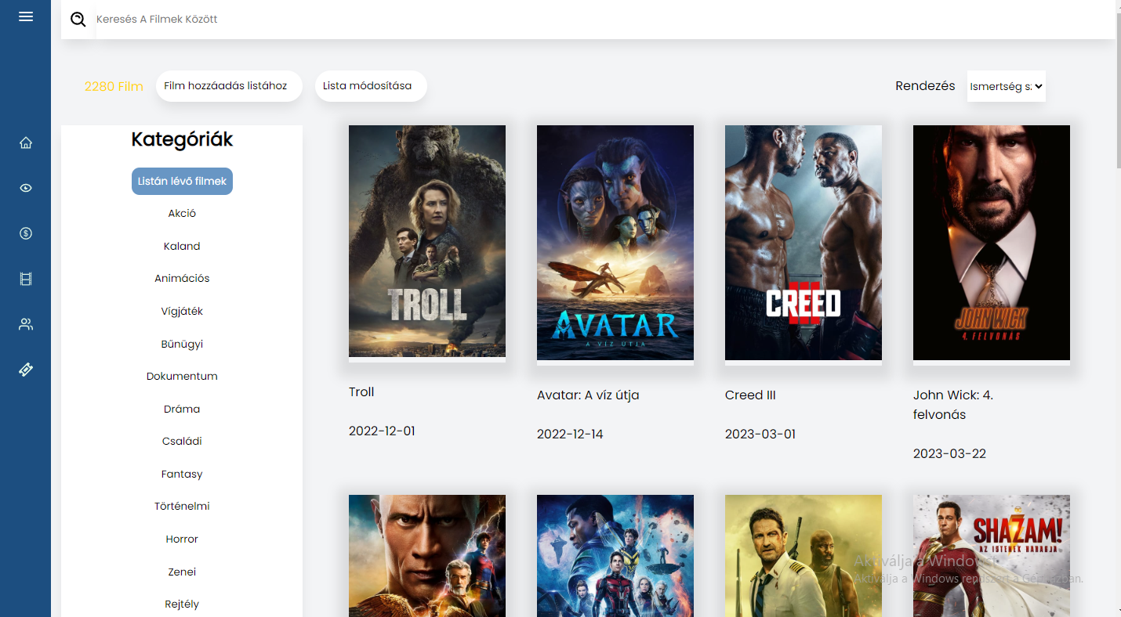

Slide 23
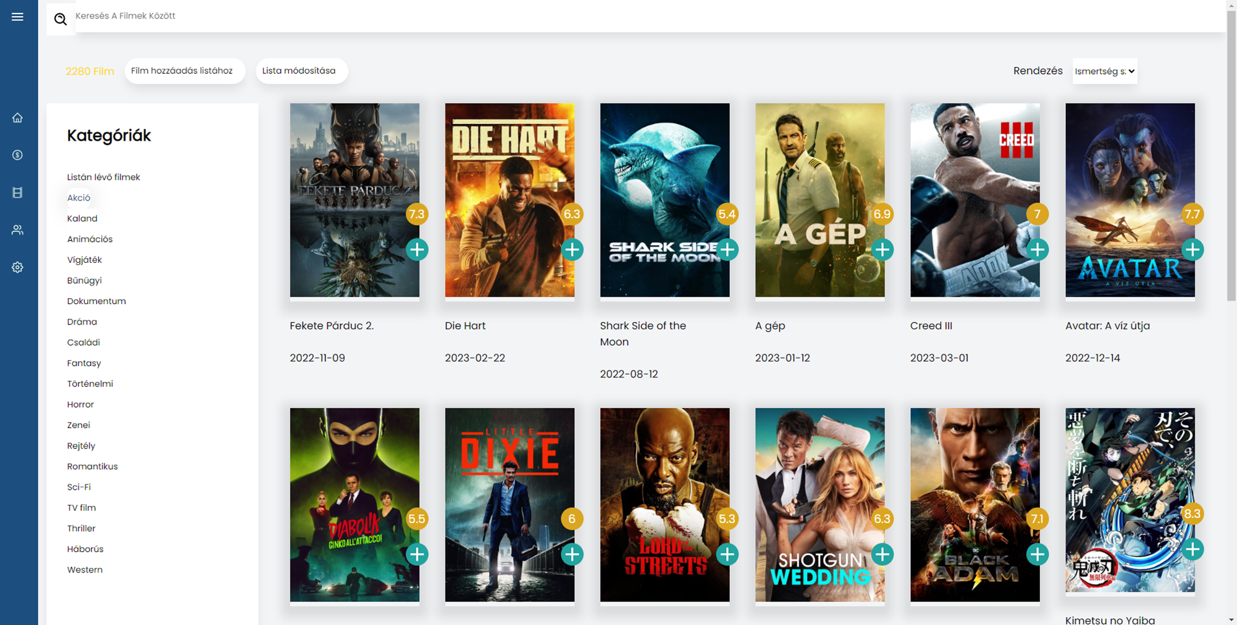
Building a page using components
Admi
N
nav
Search bar
Buttons
Filter
Categoryes
Movie
Movie
Movie
Movie
Movie
Movie
Movie
Movie
Movie
Movie
Movie
Movie

Slide 24
Thanks for your attention!

